Slide 1
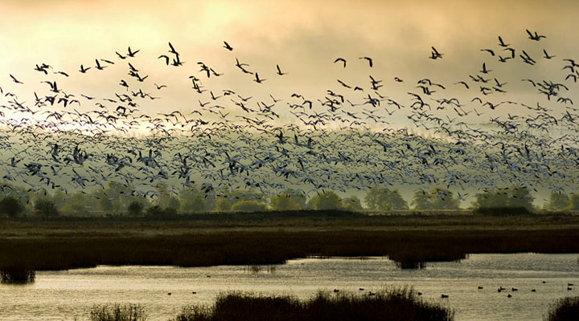
Port Susan Bay: A Change Analysis
Photo Credit: TNC (Bridget Besaw)
Stream Channel Geomorphology and Marsh Classification from 1947 to 2013
James McArdle (June 3, 2014)

Slide 2
Goals:
To classify marsh area and extent using historical and present day aerials of Port Susan Bay at the Stillaguamish River Delta
Determine channel location in 1947 and 2013 and quantify channel migration
Calculate sinuosity change in channels over time
Detect significant change in coverage from 1947 and 2013
Determine any relationship between channel migration, channel sinuosity, and the erosion or growth of marsh
Determine once and for all if the Stillaguamish river is STILL A GUAMISH?

Slide 3
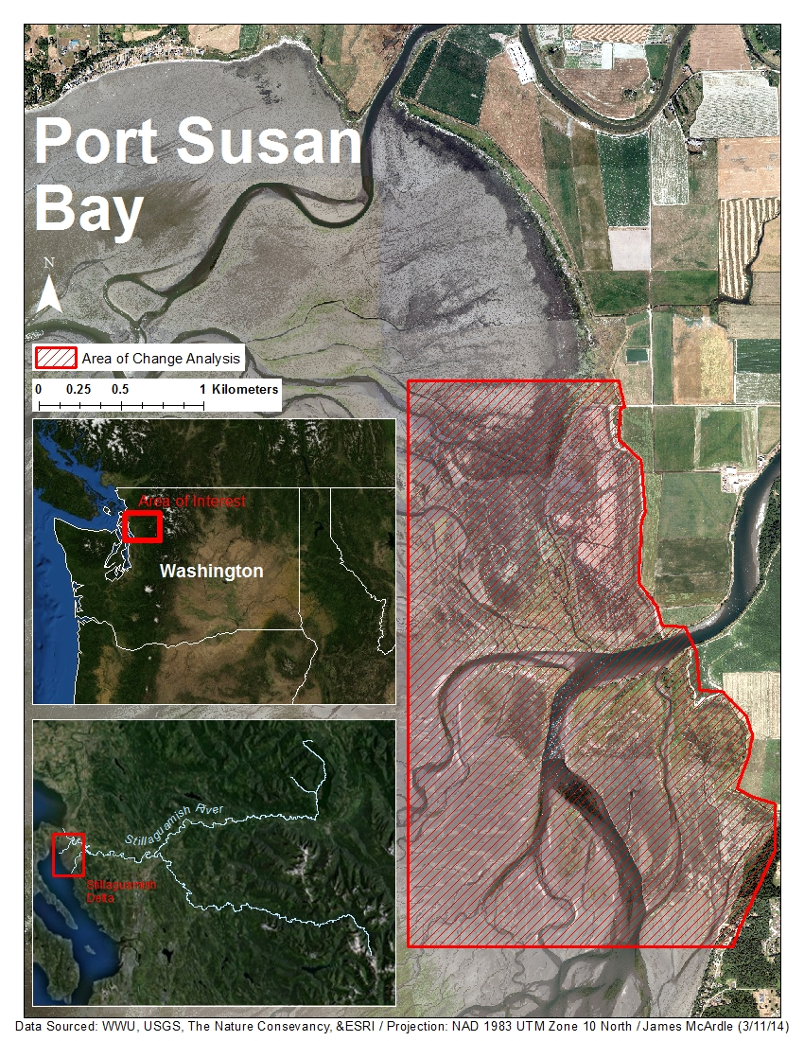
Significance of Estuary Analysis
Habitat
Water Quality
Sea level rise and implications of climate change
Flood Control of Agricultural Lands
Planning for future restoration projects

Slide 4
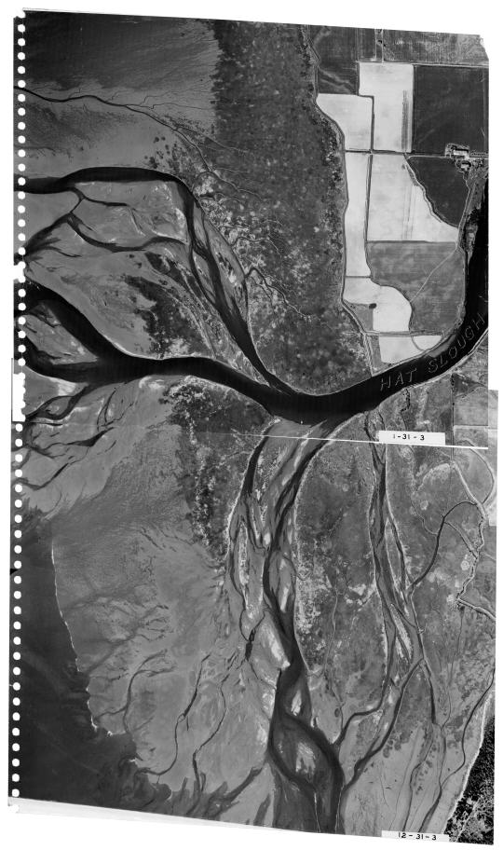
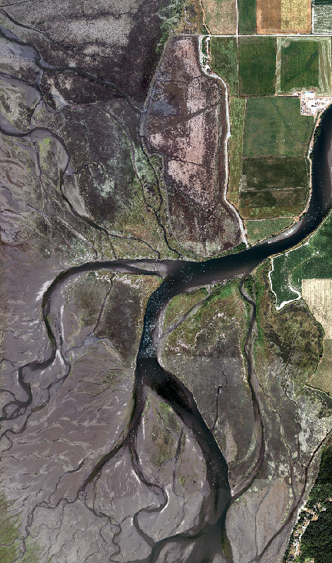
Data:
Sourced from USGS and the Nature Conservancy
Aerial Imagery
  1947 USGS Aerials (2) – 1 band image
  2013 TNC Aerials (6) – 4 band image
2013 Lidar Set
  Bare Earth and 1st Returns
Vector Data
  TNC Study Sites
  Marsh Boundary
  Marsh Salinity Polygons
All other data digitized or otherwise created

Slide 5
Methods
Digitized Thalwegs for both 1947 and 2013
  Standard digitizing methods at a scale of 1:1500
  Thalwegs determined by combination of elevation data, location of deepest, darkest, bluest, portion of the channel and basic assumptions based on standard hydrological processes.
  After completion of thalweg digitization, 6 major thalwegs were selected out based on priority flow and corresponding flows in both years.
  Thalwegs planarized, and dissolved based on Channel ID
  Sample points placed every 200 meters
  Distance calculated between stream channels and averaged using point distance tool.

Slide 6
Methods Continued…
Isodata Unsupervised Classification for the 1947 and 2013 images
  10 iterations, 5% Threshold, 5-50 classes
    Output of 50 Spectral Classes for 2013 image
    Output of 36 Spectral Classes for 1947 image
Assigned spectral classes to one of 5 of the following classes through use of true color and IR images (2013 only for IR)
  Channel or Water
  Euryhaline Unvegetated or Tide Flat
  Estuarine Mixed Vegetated – Low Marsh
  Estuarine Mixed Vegetated – High Marsh
    Break between high and low marsh determined through the use of a Mean Higher High Water line at 2.7703 meters and debris line
  Deciduous Vegetation

Slide 7
Improving Accuracy of Classifications
A series of conditional tools were used to change inaccurate classes based of elevation data (2013 image only)
After raster to polygon transformation
  Digitizing marsh lands (scale of 1:2000) and performing a multiple unions
  Editing techniques to correct misclassified areas

Slide 8
More Methods…….
Calculated percentage of marsh area change over time
Creation of Theissen Polygons for each channel Zone
  Based off of sample points and then dissolved by channel ID
Calculated sinuosity and change in sinuosity
  Length of channel / Euclidean distance from beginning to end of stream channel
Created change detection map using raster calculator
Cross referenced average channel migration distance to change in marsh area
Cross referenced change in sinuosity with change in marsh area

Slide 9
Results
Largest Channel Migration occurred in Channel B and also coincided with the most dramatic loss of water
Greatest Changes in sinuosity occurred in channels that experienced dramatic shifts in volume of flow

Slide 12
Results Continued
Zone B experienced the most low marsh growth at the expense of water loss and tide flat loss
Zone E experienced the most high marsh growth mainly at the expense of low marsh and water loss

Slide 13
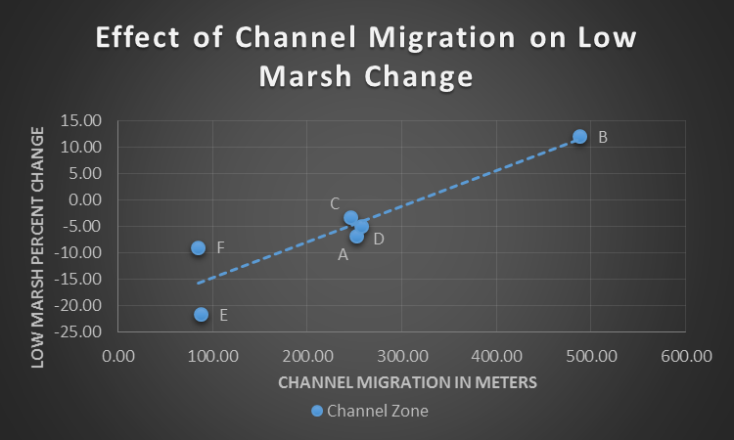
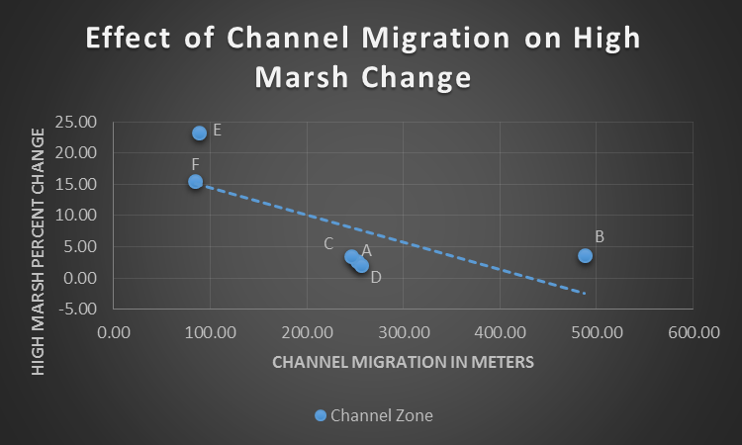
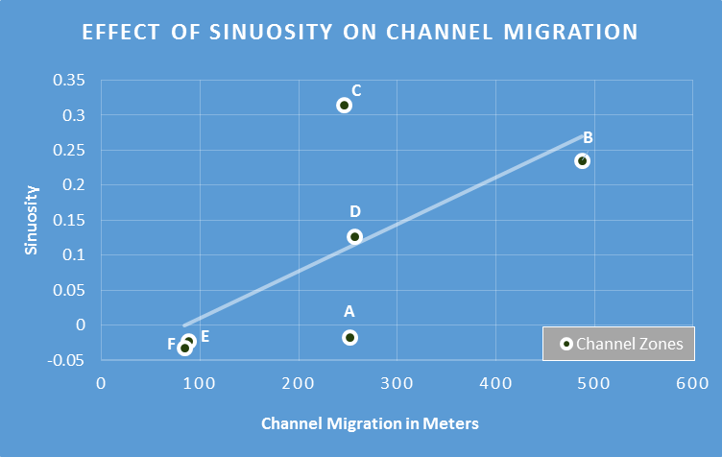
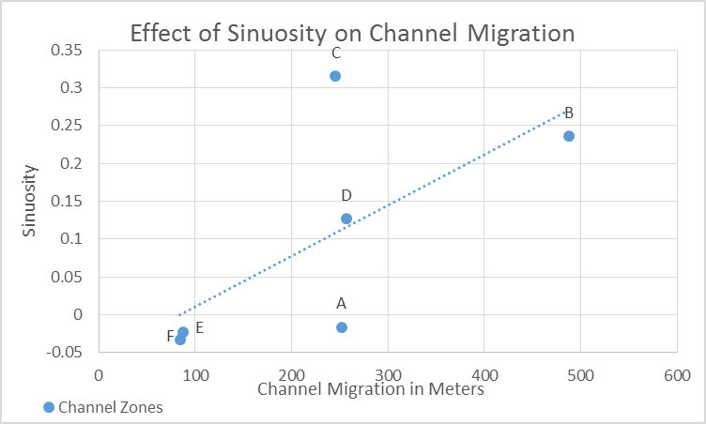
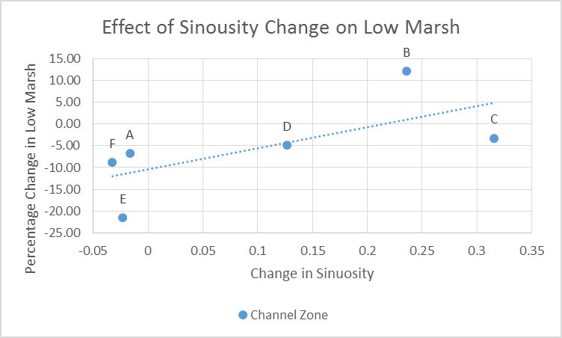
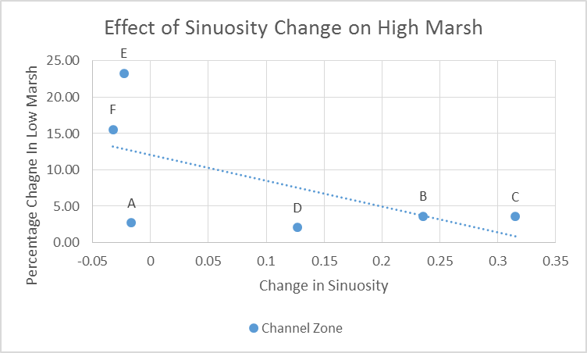

Slide 14
Discussion and Further Analysis
With a larger sample size, a better understanding of relationships between stream migration, stream sinuosity, and marsh development could be reached
  The data available very loosely indicates stream channel migration leads to an increase of low marsh and a decrease of high marsh
    Low marsh growth could be a result of increased sediment load
    High marsh decrease could be a result of elevation loss due to stream erosion
  Evaluate the role of volume and speed of water within a channel, the channel width and elevation of surrounding marsh in estuary development

Slide 15
Further Analysis and Conclusion
With minor adjustments the methods could be used for further analysis
  Increased accuracy for classifications
    Perform and Accuracy Assessment with Ground Truth Data
  Larger sample size
    More stream channels
      Not just distributary channels
      Include blind tidal channels
    Locate corresponding channels
      Methods may include using multiple datasets with more years to better track stream location
      Evaluating shorter time spans other than
Overall the process did achieve the desired results and could be repeatable

Slide 16
Literature Cited
Hood , W. G. (2006). A conceptual model of depositional, rather than erosional, tidal channel development in the rapidly prograding skagit river delta (washington, usa). Earth Surface Processes and Landforms, doi: 10.1002/esp.1381
Hood , W. G. (2002). Landscape allometry: from tidal channel hydraulic geometry to benthic ecology. Canadian journal of fisheries and aquatic science, doi: 10.1139/F02-109
Montalto , F. A., & Steenhuis, T. S. (2004). The link between hydrology and restorations of tidal marhses in the new york/new jersey estuary. Wetlands , 24(2), 414-425.
Puget Sound Nearshore Ecosytem Restoration Project., 2009, Final Geospatial Methodology Used in the PSNERP Comphrehensive Change Analysis of Puget Sound., WA Dept. of Fish and Wildlife, Seattle
Shull, S., & Bulthuis, D. A. (2002). A metodology for mapping current and historical coverage of estuarine vegetation with aerial photography and arcview. Padilla Bay National Estuarine Research Reserve, Technical Report No. 26
Stellern, C., 2013, Geomorphic Analysis and Potential Salmon Habitat of the Skokomish River Delta., ENVS-422, WWU.

